Slide 1
Medical care market performance
HSPM J712

Slide 2
Free competition
Each seller is small relative to the whole market
None has market power
  Market power means able to restrict the total supply and thus drive up the price
In a money-based system, each seller’s demand is elastic.
  You can sell as much as you want at the going market price.

Slide 3
In a free market at optimum
There is a going price.
  If there were price differences, then arbitrageurs would get rid of the price differences.
Price is forced down to cost.
  For the marginal seller.
Price is a given (for the individual seller)
  Seller adjusts to it

Slide 4
Reinhardt, U.E., "Resource Allocation in Health Care: The Allocation of Lifestyles to Providers," The Milbank Quarterly, 1987, 65(2), pp. 153-176.

Slide 5
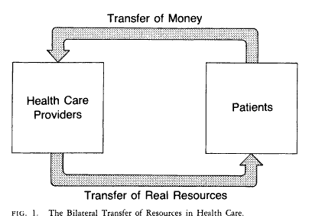

Slide 6
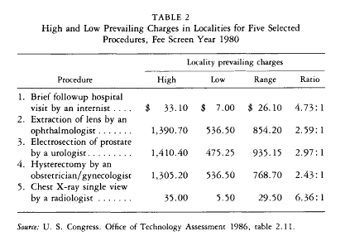

Slide 7
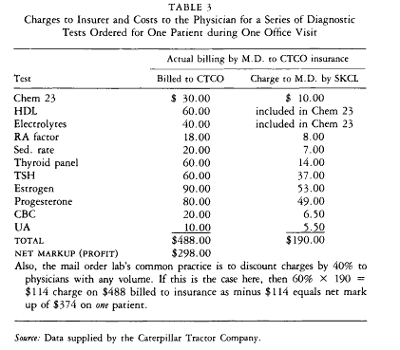

Slide 8
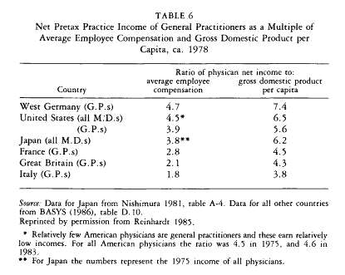

Slide 9
Does competition drive down prices and costs?
Brown, M.L., Kessler, L.G., Reuter, F.G., "Is the Supply of Mammography Machines Outstripping Need and Demand?" Annals of Internal Medicine, October, 1, 1990, 113(7), pp. 547-552. Also contrary to the competitive market model, excess capacity does not lead to price competition.

Slide 10
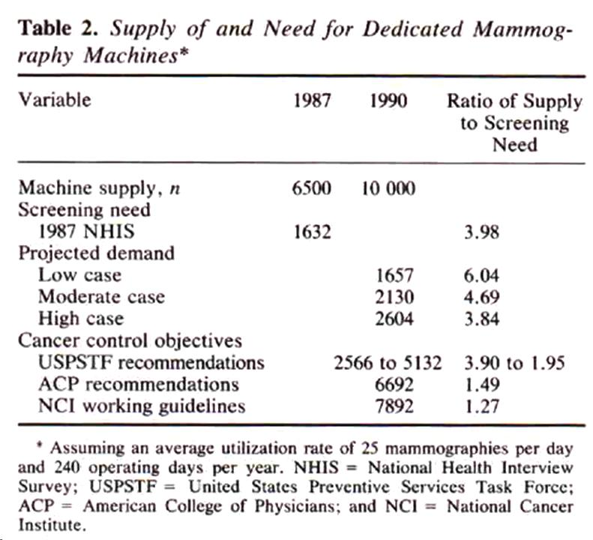

Slide 11
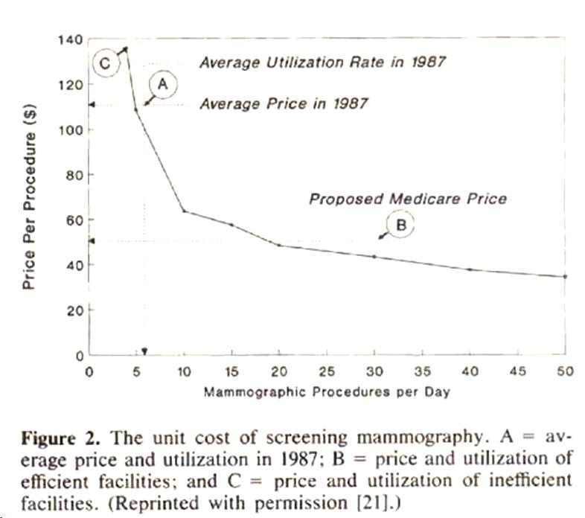

Slide 12
Hillman, B.J., Joseph, C.A., Mabry, M.R., Sunshine, J.H., Kennedy, S.D., Noether, M., "Frequency and Costs of Diagnostic Imaging in Office Practice -- A Comparison of Self-Referring and Radiologist-Referring Physicians," N Engl J Med, Dec. 6, 1990, 323(23), pp. 1604-1608.

Slide 13
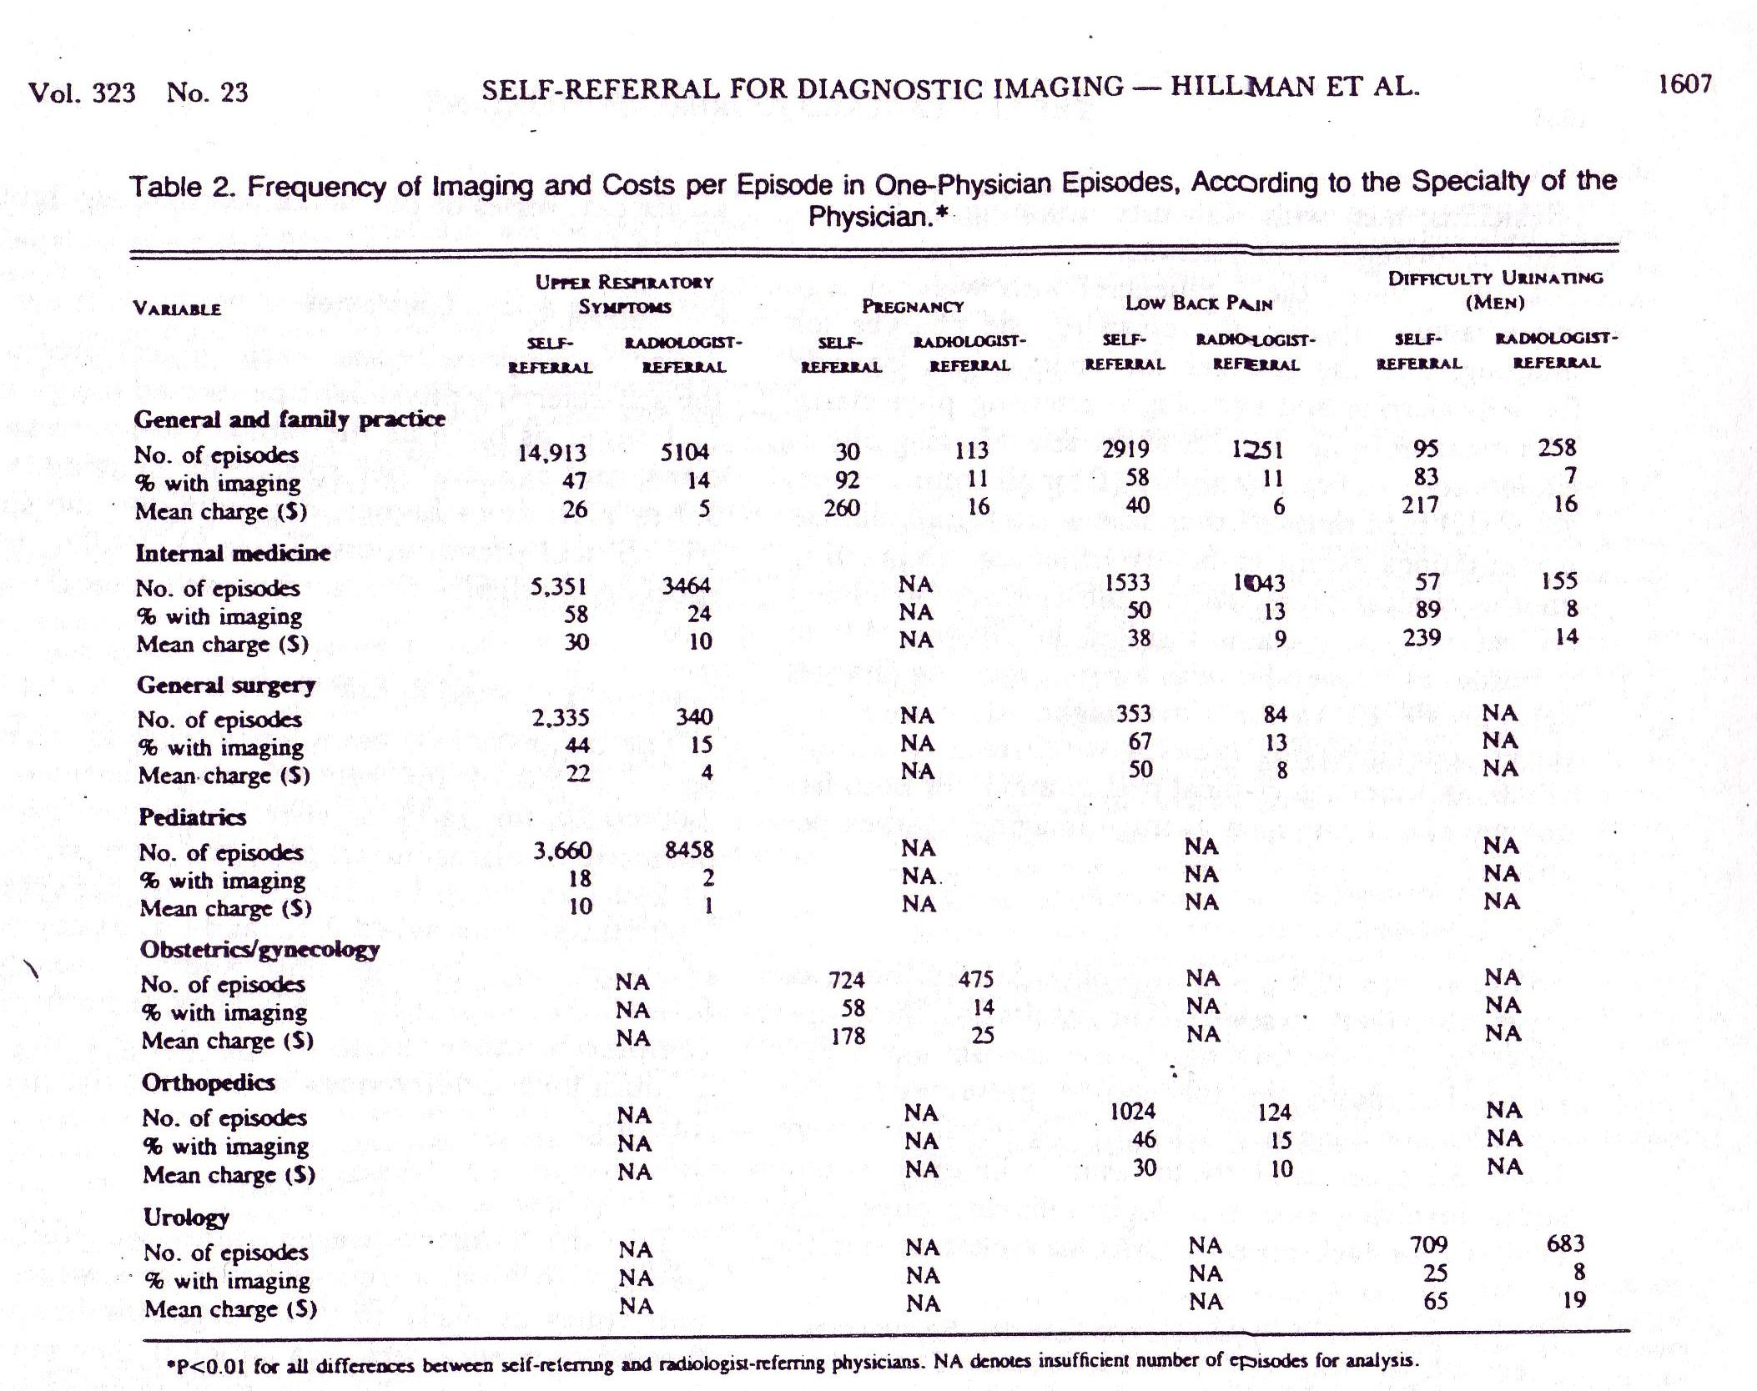

Slide 14
Pattison, R.V., and Katz, H.M., "Investor-Owned and Not-for-Profit Hospitals: A Comparison Based on California Data," N Engl J Med, August 11, 1983, 309, pp. 347-353. More differences with the competitive model: Some providers (for-profit hospitals, in this case) can charge more than other providers for the same services.

Slide 15
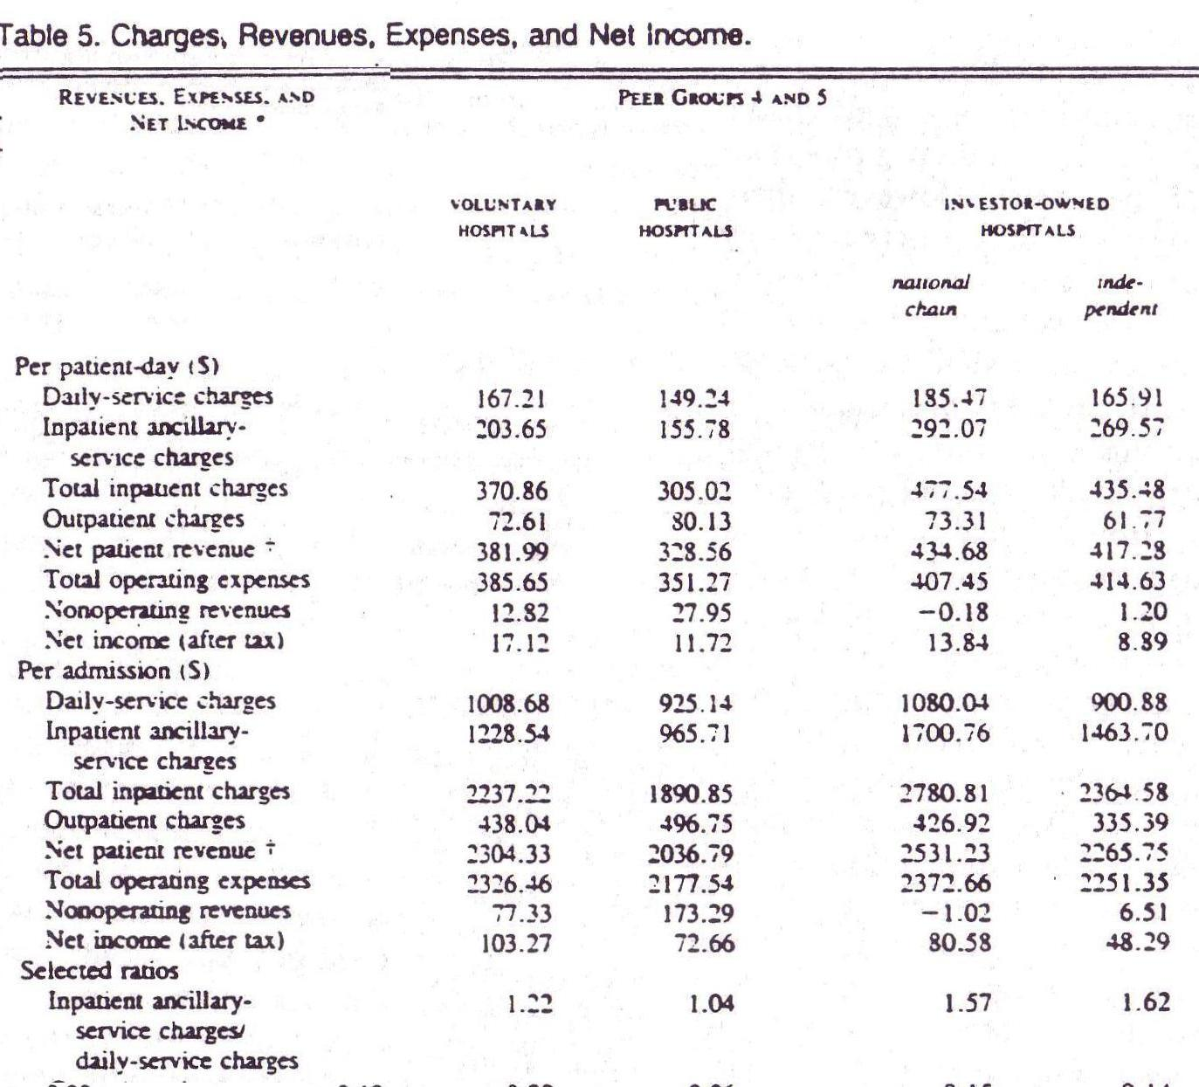

Slide 16
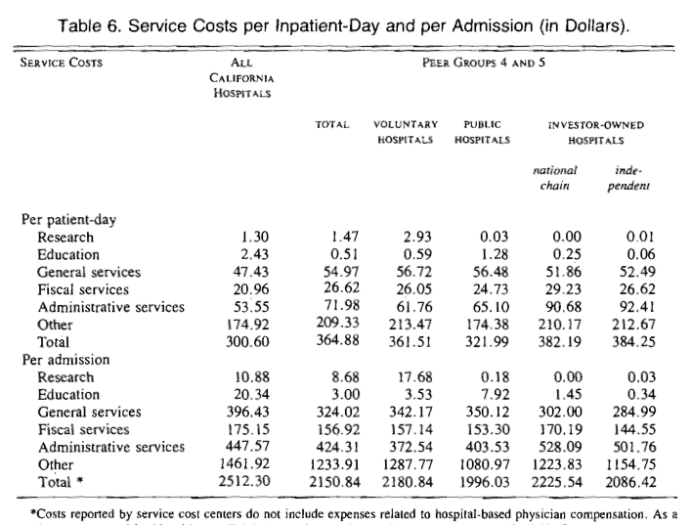

Slide 17
Woolhandler, S., Himmelstein, D.U., "Costs of Care and Administration at For-Profit and Other Hospitals in the United States," N Engl J Med, March 13, 1997, 336(11), pp. 769-74.

Slide 18
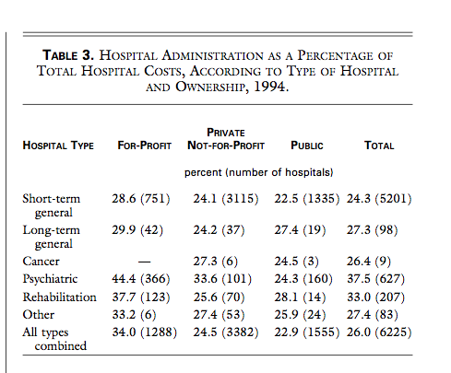

Slide 19
Reinhardt, Uwe E., "The Pricing Of U.S. Hospital Services: Chaos Behind A Veil Of Secrecy," Health Affairs, January/February 2006; 25(1): 57-69.

Slide 20
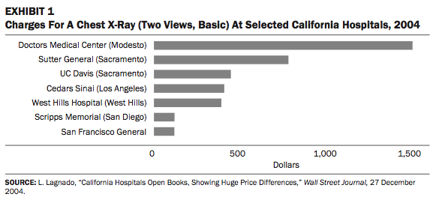

Slide 21
To move from the present, chaotic pricing system toward a … system that could support genuinely consumer-directed health care will be an awesome challenge.
Yet without major changes in the present chaos, forcing sick and anxious people to shop around blindfolded … mocks the very idea of consumer-directed care.

Slide 22
Prices are chaotic …
http://economix.blogs.nytimes.com/2009/10/16/is-medicare-raising-prices-for-the-privately-insured/
http://www.gnyha.org/8845/File.aspx
http://hspm.sph.sc.edu/Courses/Econ/Classes/provider%2520clout.hlthaff.2009.0715v1.pdf

Slide 23
…and the quantities are chaotic
http://hspm.sph.sc.edu/Courses/Econ/CLASSES/849.regional%20variation.pdf

Slide 24
Health professionals and institutions’ political contributions
http://www.opensecrets.org/industries/totals.php?ind=H01++&goButt2.x=10&goButt2.y=8&goButt2=Submit
http://http://www.opensecrets.org/industries/totals.php?ind=H02++&goButt2.x=12&goButt2.y=8&goButt2=Submit
http://www.opensecrets.org/industries/totals.php?ind=H4300&goButt2.x=10&goButt2.y=6&goButt2=Submit

