Slide 1
Administrative Cost in Health Care
HSPM J712
Oct. 27, 2010

Slide 2
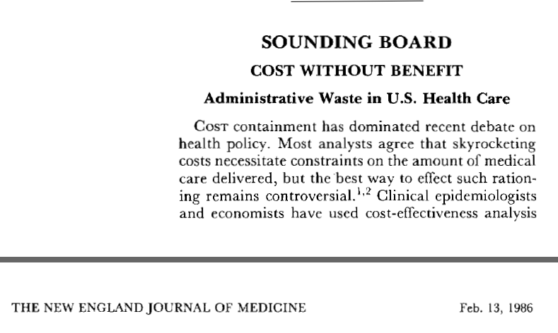
Himmelstein and Woolhandler

Slide 3
What do Himmelstein and Woolhandler include in “administrative cost?”

Slide 4
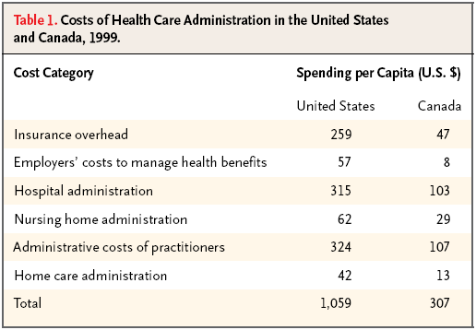

Slide 5
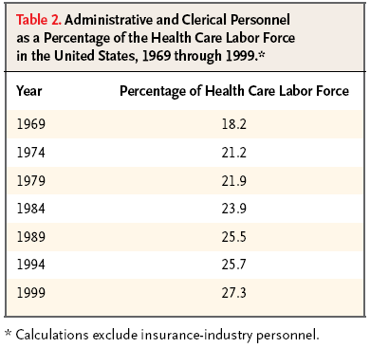

Slide 6
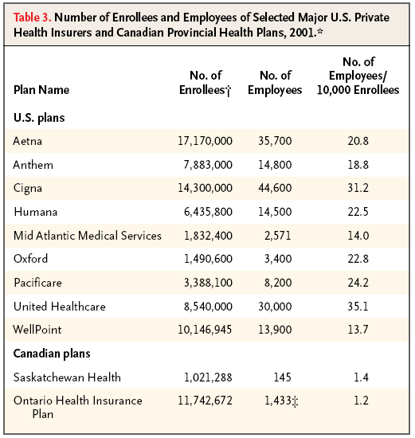

Slide 7
How can a market system be inefficient?
Grumet: “Paradoxically, the savings that ordinarily accrue to an efficiently managed business are reversed in the case of insurance carriers, whose bungling, confusion, and delay impede the outflow of funds.”

Slide 8
Rejections of claims in California
“Six of the state's largest insurers rejected 45.7 million claims for medical care, or 22% of all claims, from 2002 to June 30, 2009, according to the California Nurses Assn.'s analysis of data submitted to regulators by the companies.”
“‘… not … denials of care for consumers or widespread denials of insurance coverage,’ said [the] spokeswoman for the California Assn. of Health Plans. ‘… the so-called denials are merely paperwork issues.’”

Slide 9
Himmelstein and Woolhandler (1986), letter from James A. Cowan
Cowan: “I wonder if the U.S. public would accept the restrictions of a national health program like those in Canada and Britain.
“… it is an American virtue to expect and demand the best … The present U.S. health care system responds to this expectation by emphasizing service … This service comes at a price, part of which is high administrative overhead.”

Slide 10
Himmelstein and Woolhandler (1986), reply to letter from James A. Cowan
H&W: “Cowan seems unaware that many millions of uninsured or underinsured Americans face limitations far more severe than those confronting anyone in Britain or Canada. The high administrative overhead of the U.S. health care system is not the price of avoiding such limitations, but the cost of enforcing them.” [Emphasis is mine.]

