Slide 1
Competition and Monopoly
HSPM 712

Slide 2
Competition
How supply and demand work
  How “efficient” a market is
  As well as how equitable
… depends on competition

Slide 3
Competition in insurance, for example
Textbook ideal:
  Lower price
  Better coverage -- Higher medical loss ratio
    Oops! I mean “health benefit ratio.”
  Better service
We get that (?), but also
  Underwriting (higher premiums for the predictably sick)
  Pre-existing condition exclusions
  Retroactive cancellation

Slide 4
Textbook competition
Each firm is a price-taker
  Each is too small to influence market
  Demand curve is flat
Each firm expands production to the rate at which its marginal cost rises to equal the price.
The price sends a good signal to consumers.
  What you pay equals the opportunity cost

Slide 5
Textbook monopoly
Firm is price-maker
  Demand curve has a slope
Seller restricts production
  To raise the price
  Leads to “welfare loss” or “consumer surplus” loss
    Similar math to welfare loss from moral hazard in health insurance

Slide 6
Monopoly theory and antitrust laws
Monopoly and Competition Theory
"Monopoly" means one seller. It comes from Greek words meaning one (mono) seller (polein, which is Anglicized to "poly"). The term is used broadly to include industries of several sellers who act as one. The correct term for a "buyers' monopoly," where there is only one buyer, is "monopsony."
"Oligopoly" means a small number of sellers. The automobile industry is an example of an oligopoly. So is the hospital services industry in most small to medium-sized market areas.

Slide 7
Monopoly theory and antitrust laws
Monopoly and Competition Theory
Where is the dividing line between oligopoly and competition? The functional distinction is this: An oligopoly exists if one seller's actions can affect another seller's demand.

Slide 8
Structure, Conduct, and Performance
Economists analyze a market under three categories: Structure, Conduct, and Performance.
Structure is the context in which the actors in the market make their decisions.
Conduct is what decisions the actors make.
Performance is what we get as a result in terms of efficiency and equity.

Slide 9
Structure
Concentration: How many sellers are in the market and how big the bigger sellers are relative to the market as a whole.
Barriers to entry: How hard it is for a new firm to enter the market. Another way to think of this is: Are there potential competitors?
Product differentiation: Can you tell one firm's product from another's?

Slide 10
Conduct
Collusive behavior. Do the firms attempt to act as one?
Competitive behavior. Do the firms attempt to undercut each other?
Product differentiation. How do the firms try to distinguish their products?

Slide 11
Performance
Whether costs are minimized
Whether prices are high relative to cost
Quality
Pace of technological progress and innovation.

Slide 12
Structure-Conduct relation
Structure determines whether conduct matters.
Conduct doesn't matter in a perfectly competitive market, because any firm that doesn't minimize cost and keep its price low is out of business.
Conduct matters in monopolized markets. The monopolist may or may not take advantage of its position.
Conduct is most complex in oligopolized markets. An oligopoly can act like a monopoly, like competition, or like something else that conforms to neither of those models.

Slide 13
Natural monopolies
Natural monopolies -- if it is most efficient to have one seller serve an entire market. Local utility service may be an example, because it would be costly to have two sets of water pipes, electrical lines, or telephone lines to each house.

Slide 14
Natural oligopolies
Industries may be natural oligopolies, if there are economies of scale (larger size is less costly) to the point that the minimum efficient size firm is a substantial portion of the market. In automobiles, for example, minimum efficient sizes are large enough that it is doubtful that there could be more than a dozen or so mass-market automobile companies world-wide.

Slide 15
What monopolies do
(that we don't like)
Restrict output and raise price
  Transfer income to themselves, a distributional issue.
  Efficiency is lost, because society forgoes the opportunity to turn relatively low value resources into relatively high value products.
Allow costs to rise, thanks to lack of competitive pressure. (Allocation issue.)
Retard or distort innovation, to defend the monopoly. (Allocation issue.)
Concentrate political power.

Slide 16
Antitrust laws
Laws against monopolies in the United States:
Sherman Act of 1890
Clayton and Federal Trade Commission Acts of 1914.

Slide 17
Sherman Act
The Sherman Act of 1890 makes it illegal to "monopolize, or attempt to monopolize, ... any ... trade or commerce..."
This law is aimed at market structure. The U.S. Justice Department has the responsibility for enforcing this law.

Slide 18
The Clayton and Federal Trade Commission Acts of 1914
Prohibit monopolistic mergers and certain other forms of anti-competitive behavior.
These laws are aimed more at conduct.
The Federal Trade Commission was established by this legislation to enforce this law.

Slide 19
Justice Dept. and the FTC
That's why we have two government agencies, Justice and the Federal Trade Commissin, involved in antitrust law enforcement.
In the 1990’s, for example, it was the FTC that required Columbia/HCA to sell its Aiken hospital when it acquired a hospital in Augusta.
Also back then, the Justice Department sued two hospitals in Dubuque, Iowa, that were merging to form a local monopoly.

Slide 20
“Antitrust”
Calling anti-monopoly laws "antitrust" has its roots in the 1880's.
The "trust" was a specific form of corporate organization used by Standard Oil as it grew by merger towards being a national oil refining monopoly. Stockholders in corporations joining Standard Oil gave their shares of stock to Standard Oil. In return they got trust certificates giving them part ownership of Standard Oil.
State courts declared this arrangement illegal under then-existing state corporation law.
Standard Oil might have had to break up, but New Jersey came to its rescue by legalizing the holding company, allowing New Jersey corporations to own shares in other corporations. (Today, every state allows this.)
Standard Oil dumped the trust form of organization, moved its corporate headquarters to New Jersey, and became a holding company.
Nevertheless, the press applied the term "trust" to all large firms that were attempting to monopolize their markets, and the term has stuck to this day.

Slide 21
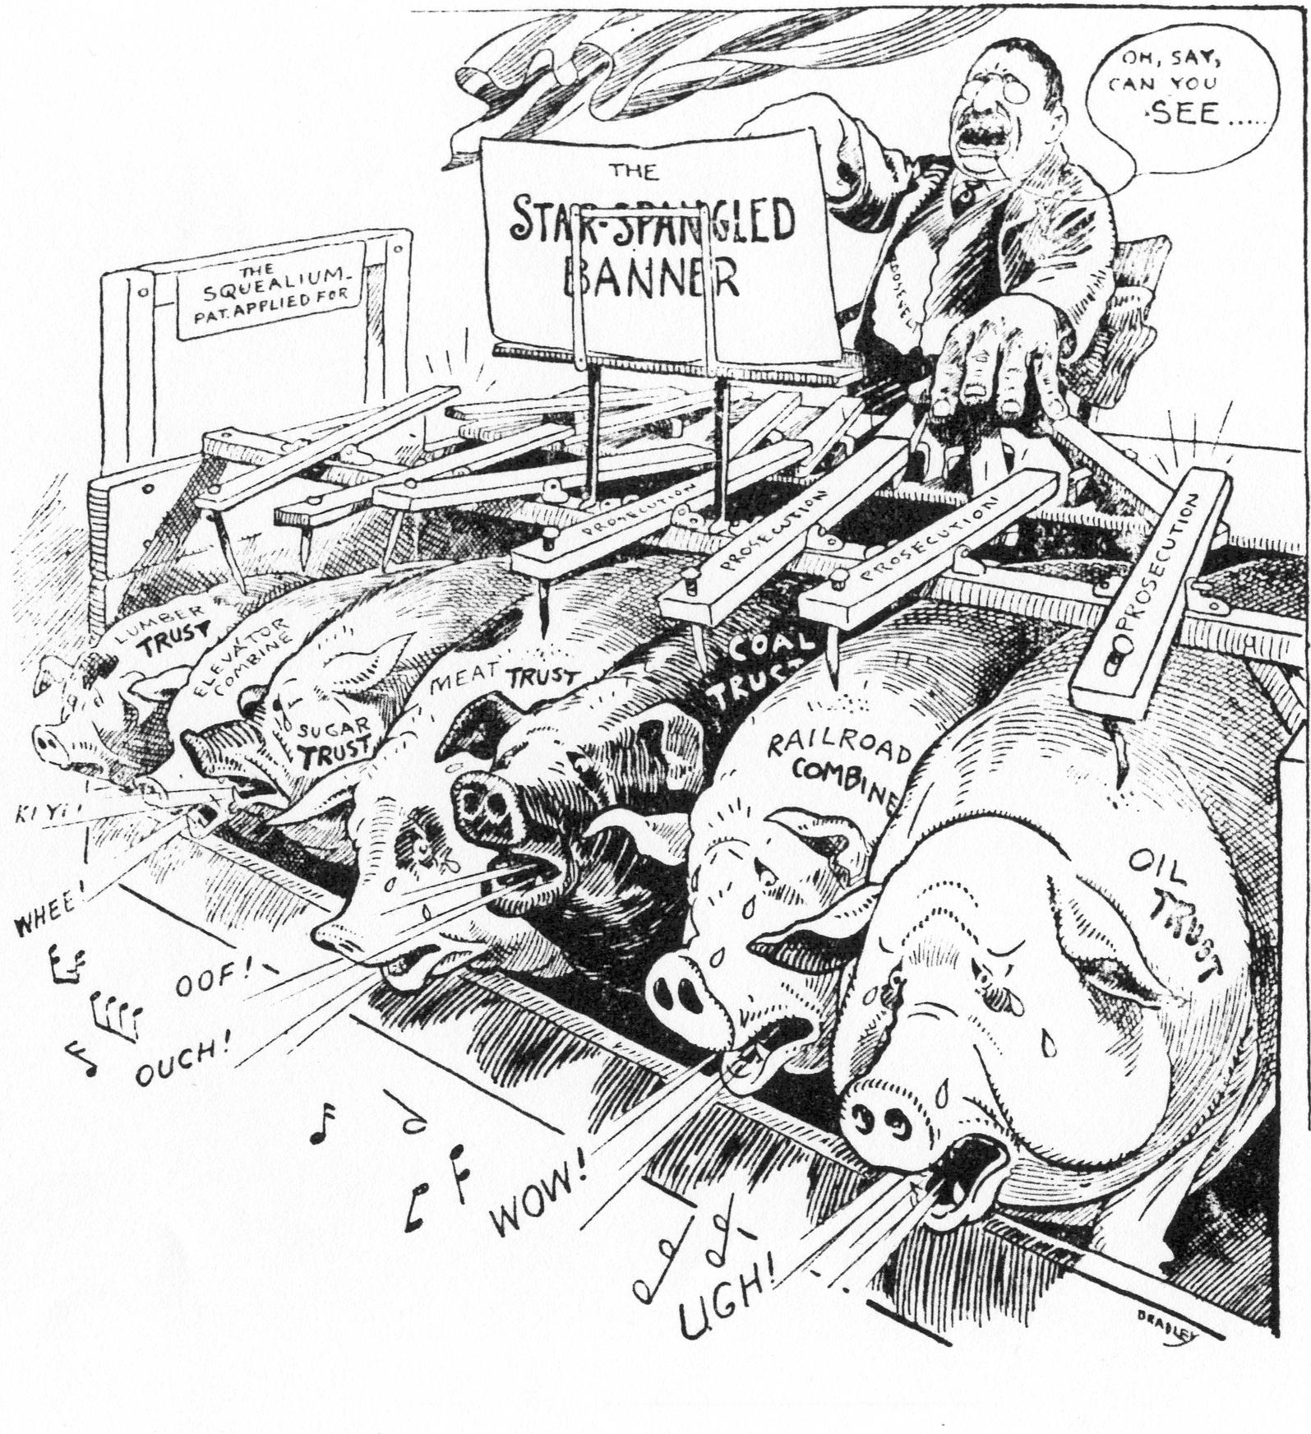

Slide 22
State antitrust exemptions relevant to health care
Federal McCarran-Ferguson act (1945)
  Insurance is “commerce” and can be regulated by the U.S. and the states
  The Sherman Act does not apply to insurance companies in states that regulate insurance.
This exemption of state-regulated industries from antitrust law is why Palmetto Health Alliance has a Certificate of Public Advantage.

Slide 23
Measuring structure
The concentration ratio
is the portion of the market controlled by the top X number of firms.
You choose the X.
Pretty straightforward, if you have market share data.

Slide 24
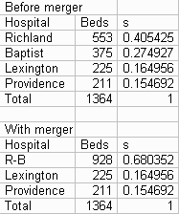
Concentration ratio example – Columbia-area hospitals 1995

Slide 25
Measuring structure
The Herfindahl-Hirschman Index (HHI)
The HHI measures concentration with the sum of the squares of the market shares of all the firms in the market.
An HHI near 0 indicates that no firms are large relative to the market -- a competitive structure.
An HHI of 1 means that there is just one firm in the market -- a monopoly structure.

Slide 26
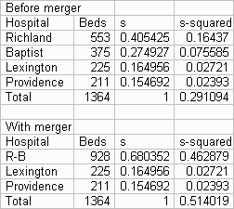
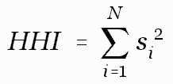
HHI for Palmetto Health merger

Slide 27
Palmetto Health’s
Certificate Of Public Advantage
Revenue per patient* will not rise faster than inflation
Will not monopolize medical practice
Savings given to community
  Savings were anticipated from reduced duplication, spreading fixed cost over more patients
* adjusted for case mix

Slide 28
COPA irony
A COPA must be actively enforced by the state.
Otherwise, a Federal court might find that the COPA was not being strictly enough enforced to provide immunity from Federal antitrust action.
Hospitals "will be forced to monitor and even encourage active state participation as a security measure against antitrust liability."
Palmetto Health finances its own regulation, by giving DHEC money to pay for independent audits of PHA’s COPA compliance.

