Slide 1
DRG’s and RBRVS
HSPM 714 J50
2013

Slide 2
How to pay for medical services
Retrospective
Prospective
Fee-for-service
Payment by condition

Slide 3
Diagnosis-Related Groups for Hospital Payment
Medicare introduced DRGs in 1983, phasing it in through 1988. SC Medicaid adopted DRG-based payment in 1986. Modified to hybrid system in 1987.
DRG-based prospective payment puts every patient into one of about 600 DRGs, according to the patient's diagnoses.
The DRG determines the payment to the hospital (except for very long stay outliers).

Slide 4
Here are some examples of DRGs and weights for the SC Medicaid system.
Payment is based on average unit payment for SC hospitals in May 1987, $1263.
DRG number | Description | Weight | Avg. length of stay | Outlier length of stay | Payment
3 | Craniotomy age<18 | 2.45 | 6.4 days | 37.4 days | $3096
33 | Concussion age<18 | 0.33 | 1.8 | 9.1 | $417
106 | Coronary bypass & cardiac cath | 8.92 | 10.9 | 25.8 | $11272
371 | C-section no complicating condition | 1.59 | 5.2 | 11.1 | $2009
373 | Vaginal delivery | 0.69 | 2.3 | 5.8 | $872

Slide 5
Diagnosis-Related Groups for Hospital Payment
Each DRG has a "weight" that represents the cost of treating such a patient relative to the average of all patients.
Payment = (The dollar amount for a DRG with weight of 1) multiplied by (the weight of patient’s DRG).
Adjusting one dollar amount adjusts all the payments.

Slide 6
SC Medicaid shortly after DRG’s started

Slide 7
The following slides show how diagnoses determine the diagnosis-related group.

Slide 8
OBS DRG DIAG1 DIAG2
1 391 V3000
2 391 V3001
3 391 V310
4 391 V3000 605
5 391 V3000 7661
6 391 V3000
7 391 V3001
8 391 V3001 7661
9 391 V3000 605
10 391 V3000
11 391 V3001
21 391 V3000
22 391 V3000
23 391 V3000 7746
24 391 V3101
27 391 V3000 7746
28 391 V3000 7661
Typical 391 diagnoses:
V3000 newborn V30 born in hospital 0
V3001 newborn born in hospital
by C-section 1
7661 large baby for gestational age
7746 jaundice
605 tight foreskin

Slide 9
OBS DRG DIAG1 DIAG2 DIAG3 DIAG4
1 390 V3000 7525
2 390 7786 7660
3 390 V301 7526 V718
4 390 V3000 7526
5 390 V3101 7784
6 390 V3000 4279
7 390 V3000 37205
8 390 V3000 76408
9 390 V3000 7526
10 390 V3000 7706
11 390 V3001 71965 7706 7746
12 390 V3000 7661 74910
13 390 V3000 7793
14 390 V3000 7706
15 390 V3000 75501
16 390 V3001 7526
17 390 V3001 V718
Some 390 diagnoses: 752.. genital organ anomalies
7784 fever
75501 extra finger
4279 heart arrythmia

Slide 10
OBS DRG DIAG1 DIAG2 DIAG3 DIAG4 DIAG5
1 389 V3000 7701
2 389 V3001 7731
3 389 7701 7718 V3001 0389 7792
4 389 7718
5 389 V3001 7708 5531
6 389 V3000 76408 7731
7 389 V3000 7661 7731
8 389 V3101 7731
9 389 V3000 7731
10 389 V3000 7731
11 389 V3000 7454
12 389 V3000 7708
13 389 V3001 7731
14 389 7756 7824
15 389 V3001 7708 7718 75462 7746
16 389 V3001 7795 7863 7706
17 389 7732 7526
Some 389 diagnoses: 770.. breathing problems
771.. infections
773.. isoimmune red blood cell destruction
775.. endocrine disorders
7795 drug withdrawal syndrome

Slide 11
Incentives in DRG-based payment
Reduce costs, because hospital keeps difference as profit (or absorbs losses)
  more efficiency of providing services
  practice changes that lower costs: fewer tests, fewer procedures, cheaper drugs, and, especially shorter stays

Slide 12
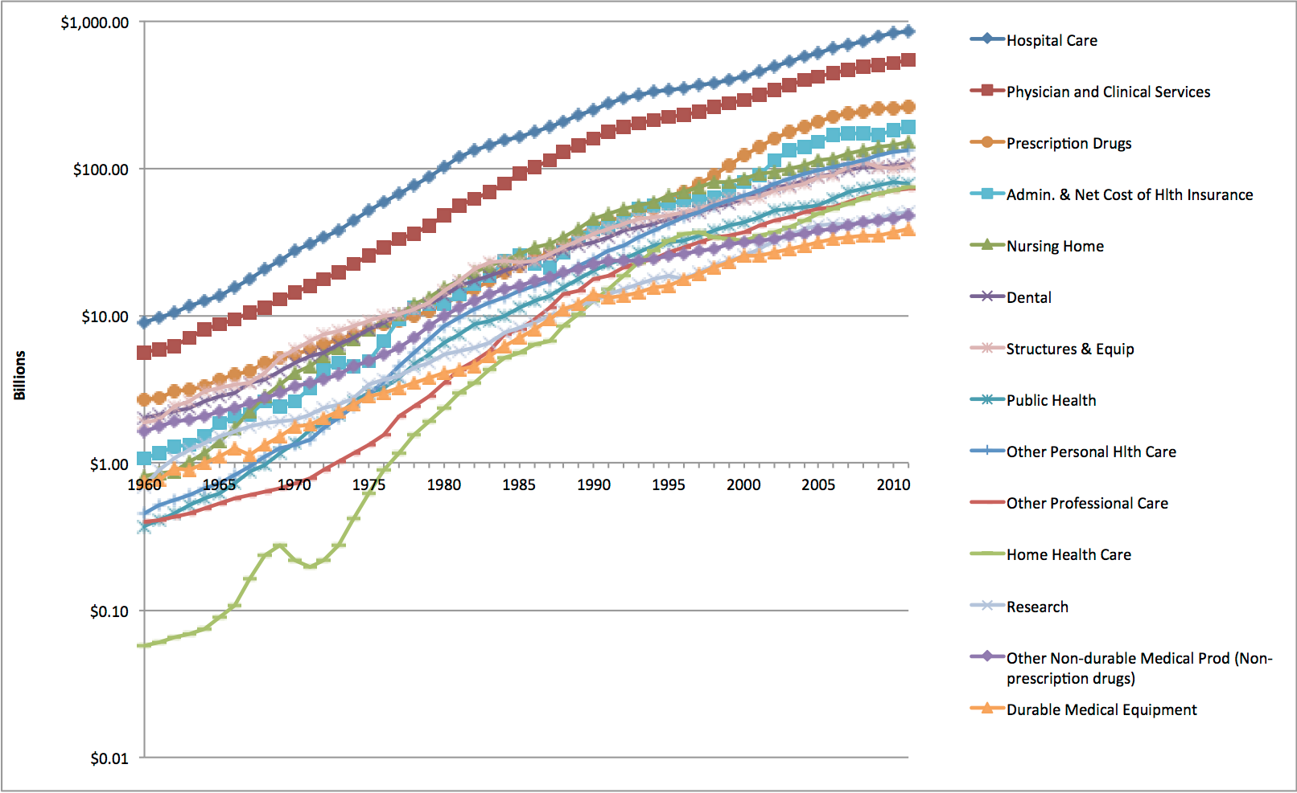

Slide 13
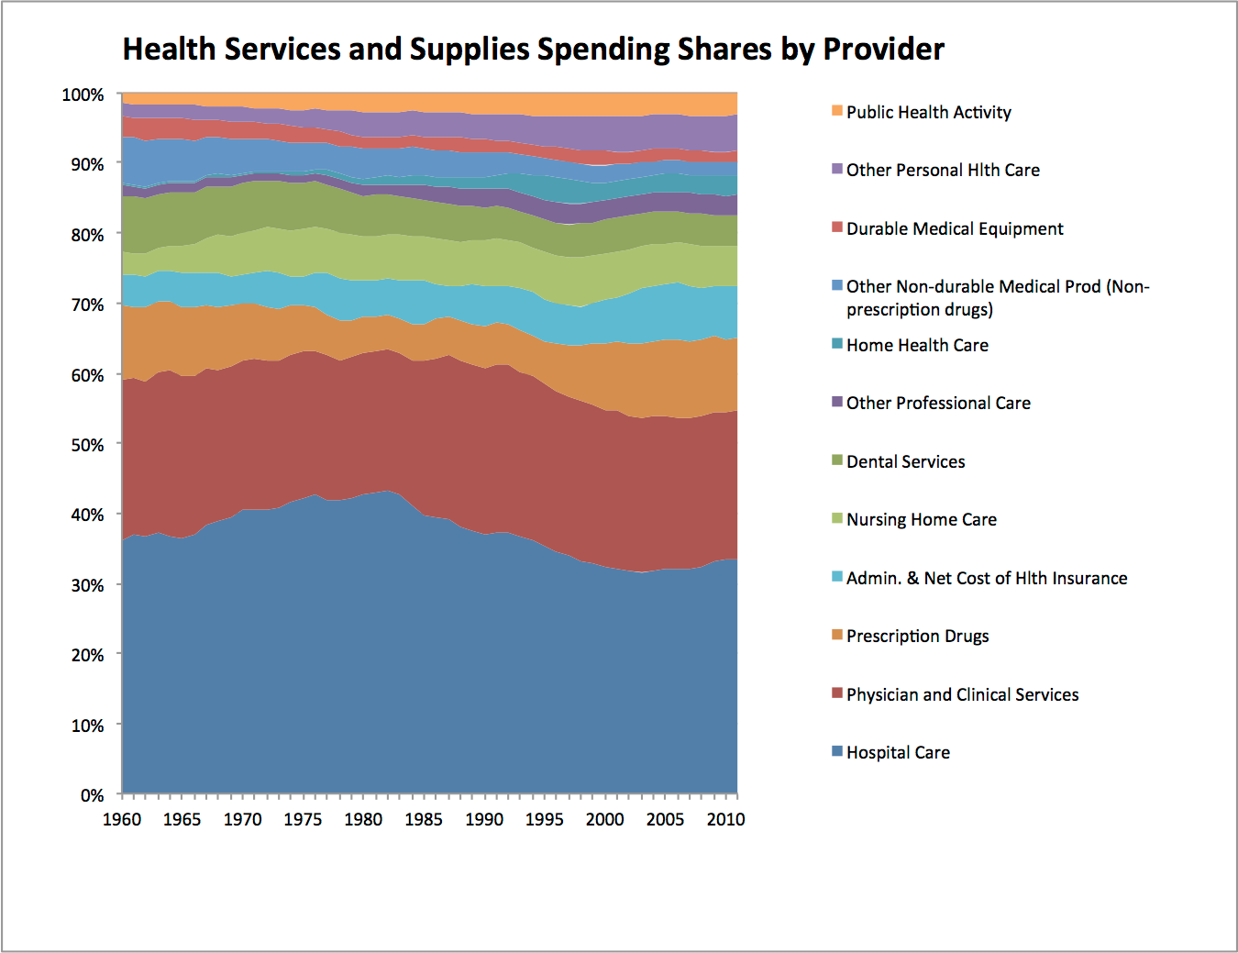

Slide 14
Early discharges …
Comparing Outcomes of Care Before and After Implementation of the DRG-Based Prospective Payment System
Katherine L. Kahn, MD; Emmett B. Keeler, PhD; et al
JAMA. 1990;264(15):1984-1988.
… a nationally representative sample of 14 012 Medicare patients hospitalized in 1981 through 1982 and 1985 through 1986 with one of five diseases. For the five diseases combined …
Length of stay dropped 24%.
In-hospital mortality declined from 16.1% to 12.6%.
30-day mortality adjusted for sickness at admission was 1.1% lower than before (16.5% pre-PPS, 15.4% post-PPS; P<.05)
180-day adjusted mortality was unchanged at 29.6% pre- vs 29.0% post-PPS (P<.05).

Slide 15
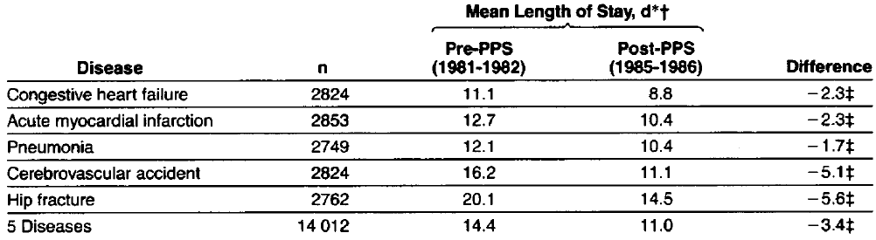
180-day post-hospital admission adjusted mortality rates were 29.6% pre-PPS and 29.0% post-PPS.
Hip fracture 180-day mortality dropped significantly. (17.9% pre- PPS and 14.8% post-PPS; P<.05)

Slide 16
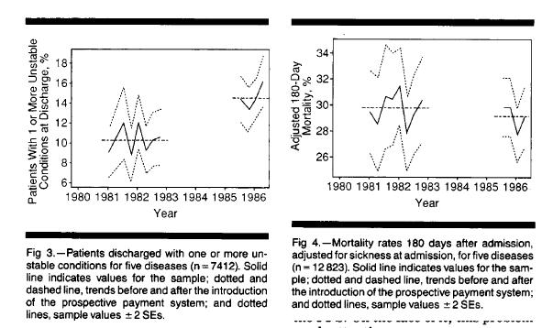
Quality of Care Before and After Implementation of the DRG-Based Prospective Payment System, A Summary of Effects
William H. Rogers, PhD; David Draper, PhD; Katherine L. Kahn, MD; Emmett B. Keeler, PhD; Lisa V. Rubenstein, MD, MSPH; Jacqueline Kosecoff, PhD; Robert H. Brook, MD, ScD
JAMA. 1990;264(15):1989-1994.

Slide 17
Early discharges …
Comparing Outcomes of Care Before and After Implementation of the DRG-Based Prospective Payment System
Katherine L. Kahn, MD; Emmett B. Keeler, PhD; Marjorie J. Sherwood, MD; William H. Rogers, PhD; David Draper, PhD; Stanley S. Bentow, MS; Ellen J. Reinisch, MS; Lisa V. Rubenstein, MD, MSPH; Jacqueline Kosecoff, PhD; Robert H. Brook, MD, ScD
JAMA. 1990;264(15):1984-1988.
Abstract
We compared patient outcomes before and after the introduction of the diagnosis related groups (DRG)-based prospective payment system (PPS) in a nationally representative sample of 14 012 Medicare patients hospitalized in 1981 through 1982 and 1985 through 1986 with one of five diseases.
For the five diseases combined, length of stay dropped 24% and in-hospital mortality declined from 16.1% to 12.6% after the PPS was introduced (P<.05). Thirty-day mortality adjusted for sickness at admission was 1.1% lower than before (16.5% pre-PPS, 15.4% post-PPS; P<.05), and 180-day adjusted mortality was essentially unchanged at 29.6% pre- vs 29.0% post-PPS (P<.05).

Slide 18
… and readmissions
"Rehospitalizations among Patients in the Medicare Fee-for-Service Program," by Stephen F. Jencks, M.D., M.P.H., Mark V. Williams, M.D., and Eric A. Coleman, M.D., M.P.H., New England Journal of Medicine, April 2, 2009, Volume 360:1418-1428.
One-fifth of Medicare patients discharged from a hospital are back in the hospital within thirty days. One-third are back within 90-days.
  Is this what we should expect with old sick people, or should we try to prevent some of this?

Slide 19
Qian, et al, Quicker and Sicker
a sharp increase in elderly patients admitted to nursing homes after first being discharged from hospital to the community.
  Earlier studies reported that patients were mostly discharged to their homes. We found that many families were apparently unable to care for such sick patients at home.

Slide 20
Qian, et al, Quicker and Sicker
As hospitals’ doctors and discharge planners learned from bad patient experiences, discharges directly to nursing homes from hospitals, which jumped initially under PPS, rose further in the late 1980s and early 1990s.

Slide 21
Qian, et al, Quicker and Sicker
Risk of readmission to hospital, from a nursing home or from the community, did not increase under PPS.
  Risk of readmission to hospital from the community eventually declined to below pre-PPS levels.
    Because nursing homes took over

Slide 22
Qian, et al, Quicker and Sicker
Nursing homes
  Paid by Fee for Service (“costs”)
Received more patients in earlier, more difficult, stages of their treatment.
  Some directly from hospitals, some from patients’ homes.
  Hospitals resisted readmitting – no payment
Nursing homes became the locus of care for many patients who would not have received their services pre-PPS.

Slide 23
Qian summary of pros and cons of DRG-based PPS for hospitals
Cons
Pros
More patients discharged unstable
Possible increase in short-term mortality, but no increase in mortality by 6-12 months
More payments for nursing home care by Medicaid and private payers.
More payments for home health care
More caregiving by families
20% less Medicare spending on hospital care, due to …
  Truncated stays
  Fewer readmissions, after the first few years.

Slide 24
DRG creep
Simborg, D.W., "DRG Creep: A New Hospital-Acquired Disease," N Engl J Med, June 25, 1981, 304(26), pp. 1602-1604.
  At the University of California at San Francisco Medical School, using records from 1978:
159 patients with a major surgical procedure plus renal disease as second diagnosis. Switching priority of diagnoses would have raised DRG-based charge by over $5000 per case.
23% of all admissions could have switched diagnoses’ order to increase payment.

Slide 25
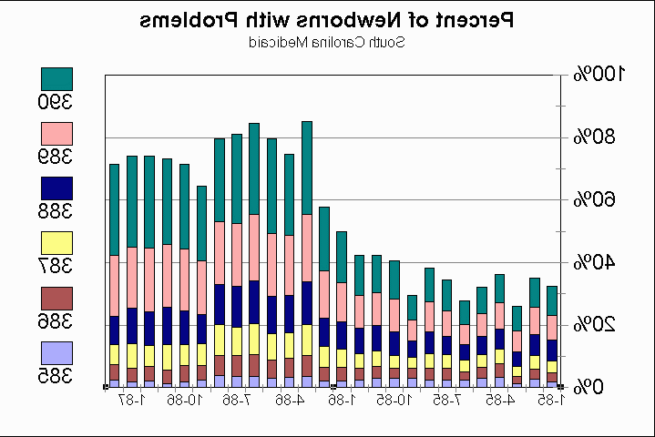

Slide 26
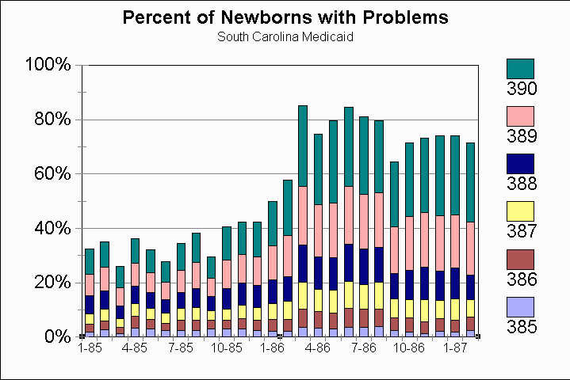

Slide 27
RBRVS

Slide 28
Resource-Based Relative Value System for physician payment
In the late 1980s, Medicare led a direct attack on how physicians set their prices. Medicare implemented the Resource-Based Relative Value System for paying doctors.
It's now used, in various forms, by private as well as public payers.

Slide 29
RBRVS = DRGs for doctors?
No
  DRG-based payment is prospective. It pays a certain amount per case, regardless of what resources the hospital puts in to the patient’s care.
  RBRVS is fee-for-service payment

Slide 30
RBRVS = DRGs for doctors?
But Yes in the sense that
  Both came from the US government
  Both simplify payment-setting
    Both based on giving a weight to each unit of service
    Weight is proportional to the cost of the service
    Costs are determined by formula, not existing market prices
    Payment = (Payment for a service with weight = 1) × (Weight of the service)

Slide 31
Historical context
  Roe, B.B., "The UCR Boondoggle: A Death Knell for Private Practice?" N Engl J Med, July 2, 1981, 305(1), pp. 41-45.
Medicare “Usual, Customary, and Reasonable” as the basis for pricing doctor services.
Invited abuse. In 1981, a heart surgeon could do three 2-4 hour coronary bypass surgeries per week at $2500 each and make $350,000 annually.

Slide 32
"The UCR Boondoggle: A Death Knell for Private Practice?"
Roe, B.B., N Engl J Med, July 2, 1981, 305(1), pp. 41-45.
Usual and Customary Rates
  New doctors could charge more than old doctors.
  Doctors could raise price to all patients and get more from Medicare.
  Making a fortune in your spare time.

Slide 33
RBRVS
RBRVS was intended to set fees by simulating the fees the market would have set if the market functioned properly.
With prices having a consistent relationship with cost.

Slide 34
Articles
Hsiao, W.C., Braun, P., Dunn, D., Becker, E.R., DeNicola, M., Ketcham, T.R., "Results and Policy Implications of the Resource-Based Relative-Value Study," N Engl J Med, September 29, 1988, 319(13), pp. 881-888.
This article, which is printed second in the original magazine, gives the general idea of RBRVS.

Slide 35
Physician work measure for RBRVS
Hsiao, W.C., Braun, P., Yntema, D., Becker, E.R., "Estimating Physicians' Work for a Resource-Based Relative Value Scale," N Engl J Med, September 29, 1988, 319(13), pp. 835-841.
This article (printed first in the NEJM issue) looks specifically at how they measured the physician's work entailed in any particular procedure.

Slide 36
Bill Hsiao, an actuary by training, was later a major consultant to the Taiwan government for the reform of its health insurance system.
Here, he suspected that physician fees were out of proportion to cost, with some surgical specialties much more handsomely reimbursed than primary care.

Slide 37
Why set fees to be proportional to cost?
Prices – sending the right signals
For physicians in training: Making the fees proportional to cost would encourage physicians to pursue careers in "primary care, rural practice, and out-of-hospital services," rather than flocking to surgical specialties.
For decision-makers: Proper fees would mean better cost-effectiveness decisions.

Slide 38
RBRVS formula
RBRV = (TW)(1+RPC)(1+AST)
Resource-Based Relative Value = (Total Work)× (Specialty Practice Cost Index)×(Specialized Training Cost Index)
Specialty practice cost is hired labor and capital
Specialized training cost is the opportunity cost of spending time in residency.

Slide 39
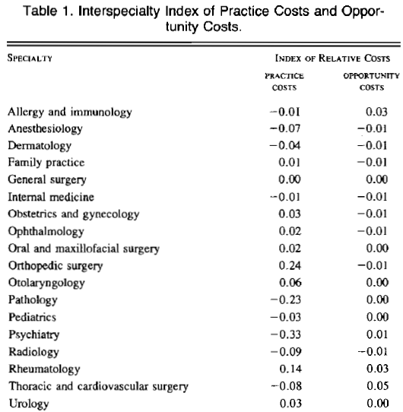

Slide 40
Total Work formula
Total Work = Time×(Complexity Index)
Complexity index = “sweat factor”
Includes Pre- + Intra- + Post-service work
Based on surveys of physicians

Slide 41
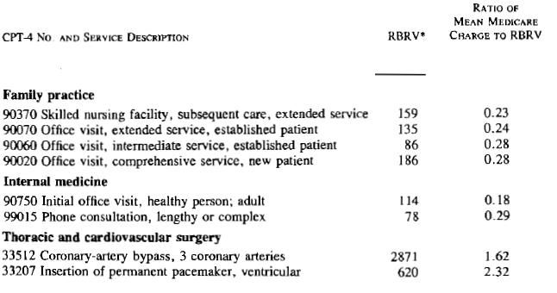
Compares actual Medicare payments with what Medicare would pay if proportional to RBRV and total-payment-neutral

Slide 42
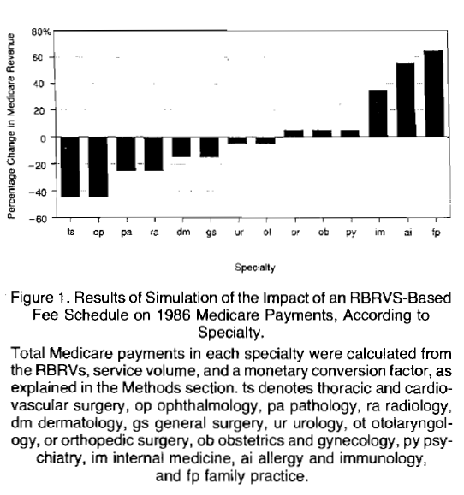

Slide 43
Potential RBRVS impact
If Medicare fees were adjusted to the RBRVS but total spending unchanged ("budget-neutral"), thoracic surgery, ophthalmology fees would drop >40%. General surgery fees would drop about 15%.
Internal medicine fees would rise >30%. Family practice fees would rise >60%.
Ontario's negotiated fee schedule more uniform relative to RBRV than mean Medicare payment.

Slide 44
Limitations of RBRVS
  which Hsiao recognized:
The CPT-4 classification system for physician services, like any classification system, has variations within the classes. Some docs, such as those who treat poor people, may have more difficult patients within RBRV classes.
No extra payment is allowed for better outcomes. RBRVS is based on resource inputs, not benefits. There's no financial incentive for higher quality.

Slide 45
As implemented by SC Medicaid
Naus, F., Medical Management Institute 1991
Nose fracture CPT 21325
RVU category | US | SC adj | SC RVU
Work RVU | 174 | 0.971 | 169.1
Overhead RVU | 120 | 0.874 | 105.1
Malpractice RVU | 20 | 0.457 | 9.14
Total | 314 |  | 283.3

