Slide 1
Wennberg, Tracking Medicine

Slide 2
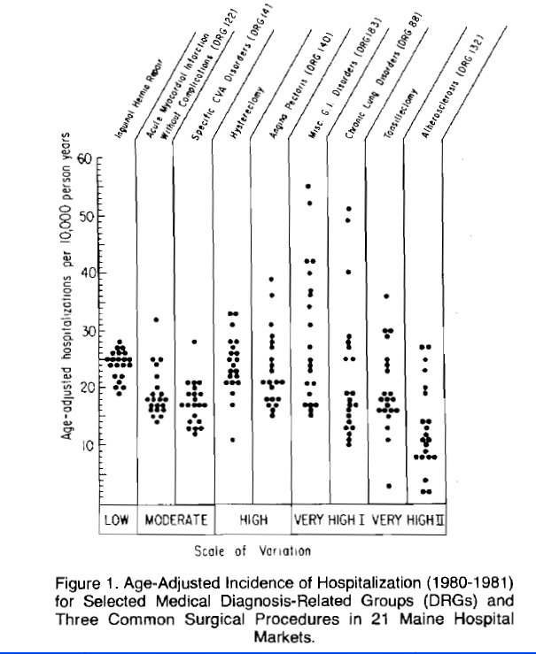

Slide 3
Epidemiology of Medical Care
Three types of medical care

Slide 4
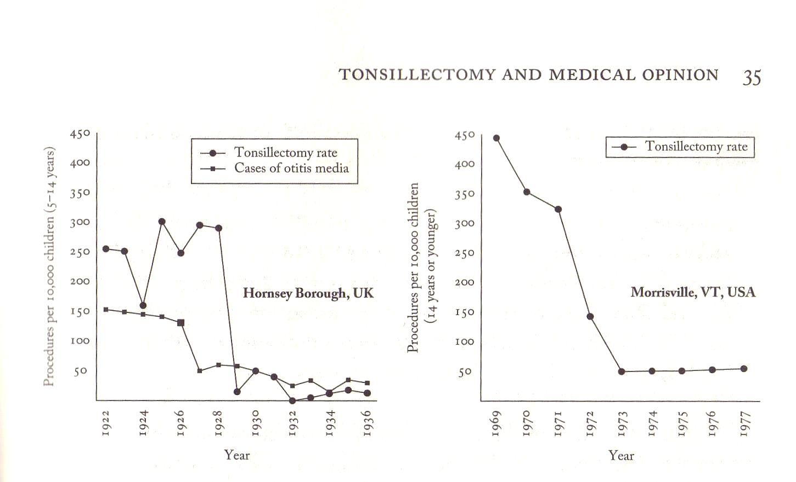

Slide 5
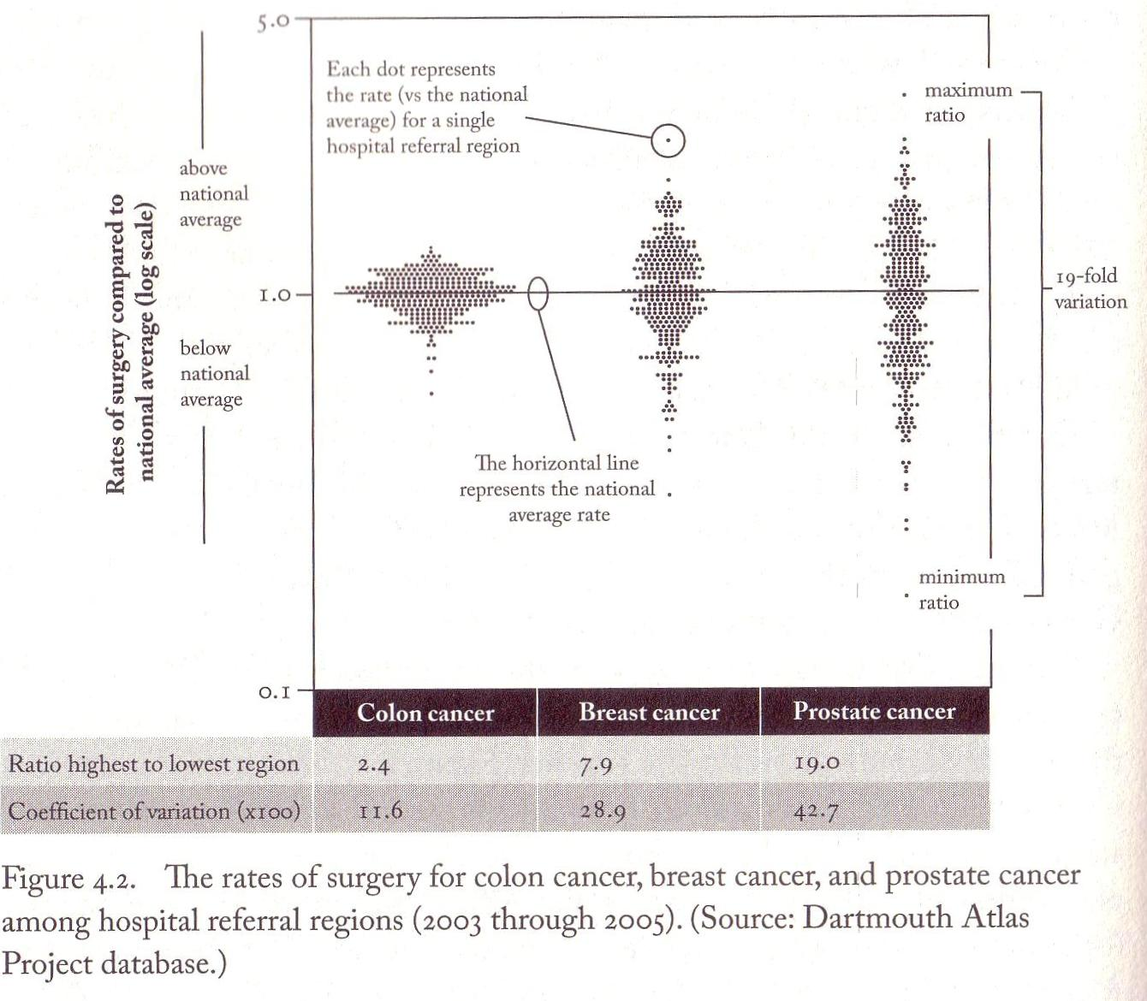
Notes:
Coefficient of variation = standard deviation divided by the mean

Slide 6
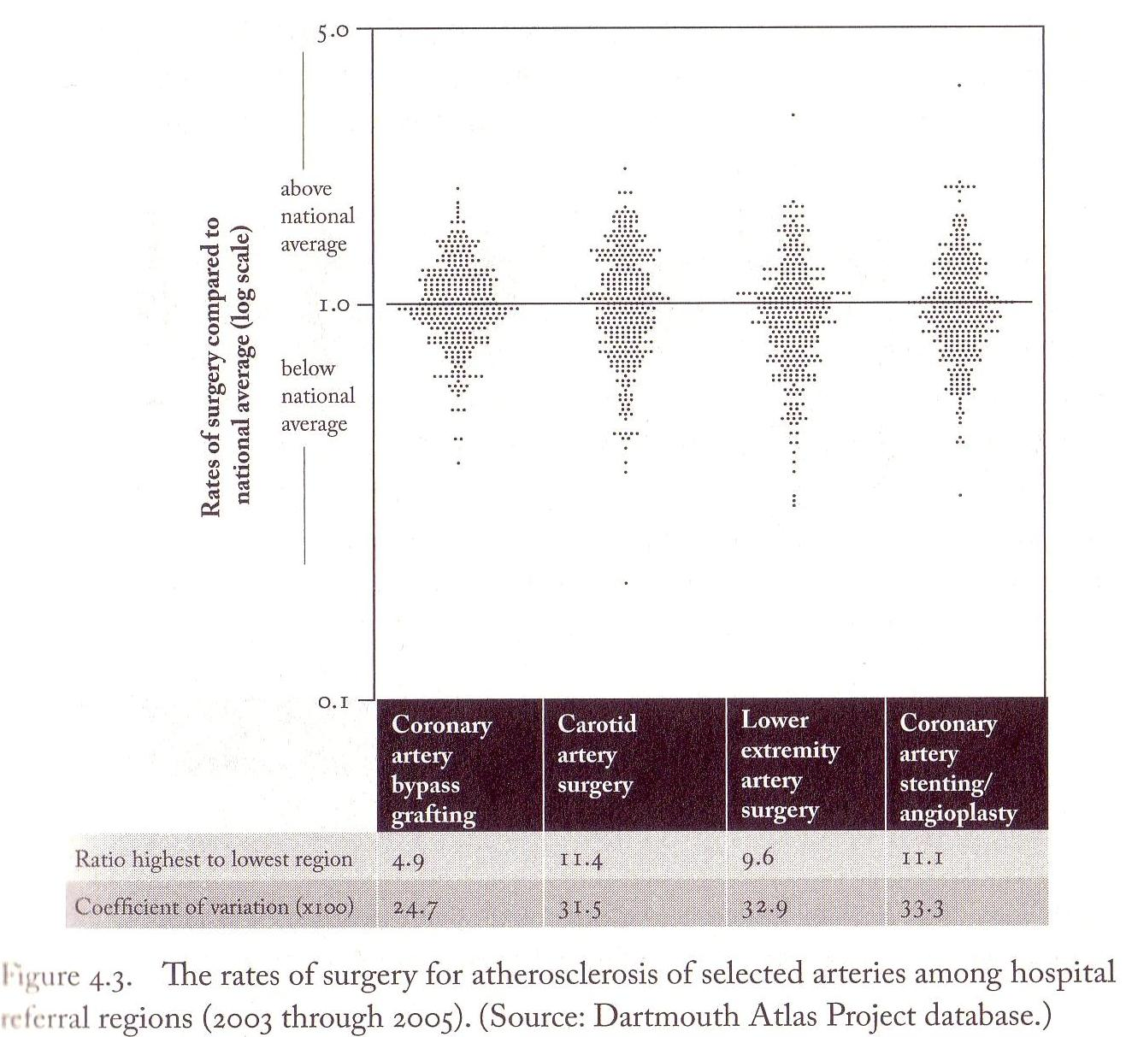

Slide 7
