Slide 1
Managed care
HSPM 714 J50

Slide 2
Fee for service or charity
Independent self-employed doctors
  Paid fee-for-service
  Not hospital employees
Hospitals
    Before aseptic surgery, hospitals were places for poor people to go to die.
    Or get free care (“dispensaries”)
  Then became doctors’ workshops
    Built by philanthropic organizations (non-profit)
    Or doctors as owners (for-profit)

Slide 3
Fee-for-service
Insurance
  Blue Cross trademark owned by American Hospital Association
  A pre-payment collection agency for the hospitals
  Blue Shield added for doctors
  Buick was “the doctor’s car”

Slide 4
3d party payment
Doctors and hospitals
Insurance
Patient

Slide 5
Prepaid group practice system
Doctors
Hospitals
Insurance
Patient

Slide 6
Capitation
A fixed amount of money per person (head) per year to pay for health care
Insurance introduces capitation
For-profit or independent non-profit insurance has incentive to control payment
  Payouts to providers are costs to the insurer.

Slide 7
Fee-for-service incentive
Gives the provider an incentive to do more
  Contrary to the insurer’s incentive

Slide 8
How to conquer the incentive conflict
Make the doctor a partner – prepaid group practice
Utilization control – rules on what insurer will pay for
Bonuses and penalties, depending on doctor
All three are used by “managed care” and by “health maintenance organizations”

Slide 9
Health Maintenance Organization
Capitation’s advertised incentive
  Maintain enrollee’s health
    But prevention is often not medical-cost-saving
Capitation’s other incentives
  Selection
    Screen out costly enrollees
  Scrimping

Slide 10
Undermining trust
  A principal-agent problem
FFS – pays provider to do more than you need
HMO – pays provider to do less than you need

Slide 11
HMO history

Slide 12
Mayer, T.R., and Mayer, G.G., "HMOs: Origins and Development"
N Engl J Med, February 28, 1985, 312, pp. 590-594.
History of prepaid group practice, the precursor of modern HMOs.
Early prepaid group practice doctors were rebels, who had to fight medical societies at every step.
The first prepaid group practice remembered today began around 1910 in Tacoma, Washington, where two docs contracted with lumber firms to provide care for workers for a capitation payment of 50 cents per month. Grew to a chain of 20 clinics in Washington and Oregon.

Slide 13
First HMO’s and insurance
1927 – first prepaid hospital care.
  In Elk City, OK, a doc built a community hospital by selling shares to finance construction. Shareholders ($50/each) got free care at the hospital. [Inspired by stock market boom, not Depression.]
1929 – first hospitalization insurance. School teachers could pay $0.50/month and get free care at the Baylor Hospital in Dallas.

Slide 14
Medical Societies vs. the HMOs
To most doctors, prepaid practice represented a threat to individual proprietorship practice.
In Elk City, the local medical society ejected the doc. The state licensing board tried to take away his license, and discriminated against any doc who would work at that hospital.
Meantime, the doc toured the country during the 1930s and '40s encouraging farmers to set up similar plans.
  One of those plans was the Group Health Cooperative of Seattle, that later was used in the RAND experiment (Ware article). It, too faced medical society opposition, which led to a court battle that the med soc lost in 1957.

Slide 15
Medical Societies vs. the HMOs
Other early capitation clinics were in Los Angeles (1929), where docs were also ejected from med soc.
1930s Oregon doctors boycotted hospitalization insurance plans, but soon ...
What to do about capital requirements beyond what an individual doctor could afford? Non-profit hospitals, at which doctors are not employees, but are "staff" with decision-making power.
The AMA embraced Blue Cross (Baylor plan) as an preferable alternative to prepaid group capitated practice.

Slide 16
HMO history
Other early HMOs were
  the Group Health Plan of Washington DC (1937),
  Kaiser plan in California (1942),
  HIP of NY (1944).
In 1970 there were about 30 PGPs in US.
By 1975 there were 166.
By 1985 there were 300+ plans with 15 million members.
By mid-1990s, membership was over 40 million.

Slide 17
Government policy and HMOs
HMOs exempted from insurance regulation
  For insurance companies, it’s to guarantee solvency.
  Prepaid group practice got special lenient treatment by the states, with little or no cash reserve required.
  Prepaid practice pays in service, not in money. That was the rationale.

Slide 18
Early 1970s:
The Nixon Administration and Congress supported HMOs.
For conservatives,
For liberals
HMOs were a market alternative to national health insurance. (The term "HMO" was coined by Paul Ellwood in 1971 to appeal to them.)
HMOs were a potential way that a national health insurance system could be managed, as was later attempted in the 1993 Clinton plan.

Slide 19
What drove HMO growth
A 1973 law established subsidies for HMO start-up and
required that employers allow employees to join a Federally qualified HMO if one existed in their area.
The law also encouraged IPAs (Independent Practice Associations)
  IPAs were also called Foundations
IPAs were docs' attempts to compete with PGPs while maintaining independence.
The IPAs grew and spread faster than prepaid group practices.

Slide 20
Antitrust and HMOs
Antitrust laws -- their extension to medical practice crucial to development of HMOs.
1975 case involving lawyers -- US Supreme Court removed exemption for "learned professions" from antitrust laws, which apply to "trade" or "commerce.“
  1895 Sugar Trust case: Manufacturing was not “commerce”
Early 1980s court decisions applied that principle to docs and dentists
  Dentist boycott of insurers ruled "conspiracy in restraint of trade"
  Denial of hospital privileges to HMO docs -- ditto
  Restrictions on advertising – ditto

Slide 21
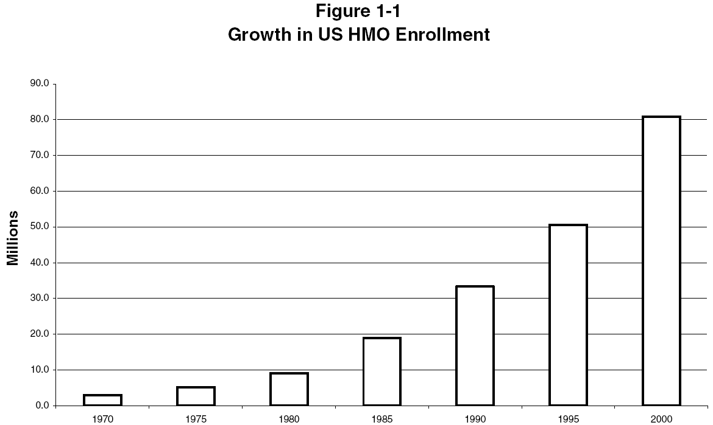
The Rise of HMOs, Martin Markovich http://www.rand.org/pubs/rgs_dissertations/RGSD172/RGSD172.ch1.pdf

Slide 22
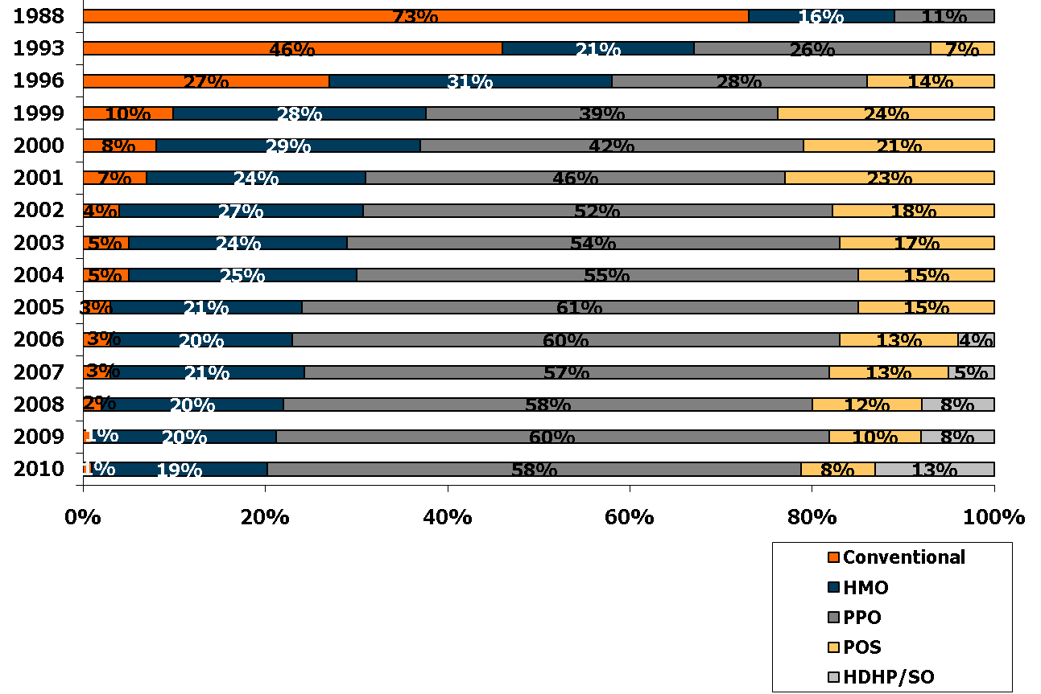
Distribution of Health Plan Enrollment for Covered Workers, by Plan Type, 1988-2010
*
*
*
*
*
*
* Distribution is statistically different from the previous year shown (p<.05). No statistical tests were conducted for years prior to 1999. No statistical tests are conducted between 2005 and 2006 due to the addition of HDHP/SO as a new plan type in 2006.
Note: Information was not obtained for POS plans in 1988. A portion of the change in plan type enrollment for 2005 is likely attributable to incorporating more recent Census Bureau estimates of the number of state and local government workers and removing federal workers from the weights. See the Survey Design and Methods section from the 2005 Kaiser/HRET Survey of Employer-Sponsored Health Benefits for additional information.
Source: Kaiser/HRET Survey of Employer-Sponsored Health Benefits, 1999-2010; KPMG Survey of Employer-Sponsored Health Benefits, 1993, 1996; The Health Insurance Association of America (HIAA), 1988.

Slide 23
Cost and utilization differences -- Does a prepaid group practice deliver less care than the fee-for-service system when both serve comparable populations with comparable benefits?
“A Controlled Trial of the Effect of a Prepaid Group Practice on Use of Services,”
  Willard G. Manning, Ph.D., Arleen Leibowitz, Ph.D., George A. Goldberg, M.D., William H. Rogers, Ph.D., and Joseph P. Newhouse, Ph.D., N Engl J Med 1984; 310:1505-1510 June 7, 1984

Slide 24
Cost and utilization differences -- Does a prepaid group practice deliver less care than the fee-for-service system when both serve comparable populations with comparable benefits?
RAND randomly assigned 1580 persons like this:
431 received care free of charge, with the plan paying fee-for-service.
1149 received care free of charge from the Group Health Cooperative of Puget Sound.
In addition, 733 prior enrollees of the Group Health Cooperative were studied as a control group.

Slide 25
Cost and utilization differences -- Does a prepaid group practice deliver less care than the fee-for-service system when both serve comparable populations with comparable benefits?
40% fewer hospital admissions for both groups at the Group Health Cooperative,
  in comparison with the fee-for-service group
Ambulatory-visit rates were similar.
25% less spending all services in the two Group Health groups,
  compared with the fee-for-service group.
More preventive visits for both groups with the Group Health Cooperative.

Slide 26
Cost and utilization differences -- Does a prepaid group practice deliver less care than the fee-for-service system when both serve comparable populations with comparable benefits?
The two Coop groups used similar services.
One of those groups was randomly assigned by RAND to be similar in health status to the fee for service group. Therefore, fee-for-service group probably had risks to the group of people already in the Coop.
Also therefore: The Coop’s lower costs were not due to risk selection.
Conclusion: Medicine at the prepaid group practice was much less hospital-intensive and, consequently, less expensive.

Slide 27
Outcome differences
Ware, J.E., et al, "Comparison of Health Outcomes at a Health Maintenance Organisation with Those of Fee-for-Service Care," Lancet, May 3, 1986, pp. 1017-1022.
For non-poor individuals who were initially in good health, outcomes were similar.
Among the high-income initially-sick, Coop patients showed more improvement in cholesterol levels and in general health ratings than did the free FFS care patients.
Among the low-income initially-sick, the Coop patients had more bed-days per year due to poor health and more serious symptoms than the patients with free FFS care. Coop patients had a greater risk of dying.

Slide 28
Outcome differences
That HMOs were less effective for lower-income people was a known phenomenon, written about as early as 1972.
The Group Health Cooperative had an outreach program for its low-income members.
RAND insisted that the outreach not be done for people that were being followed in this experiment.

Slide 29
Focus on hospital utilization
Siu, A.L., Leibowitz, L., Brook, R.H., Goldman, N.S., Lurie, N., Newhouse, J.P., "Use of the Hospital in a Randomized Trial of Prepaid Care," JAMA, March 4, 1988, 259, pp. 1343-1346.

Slide 30
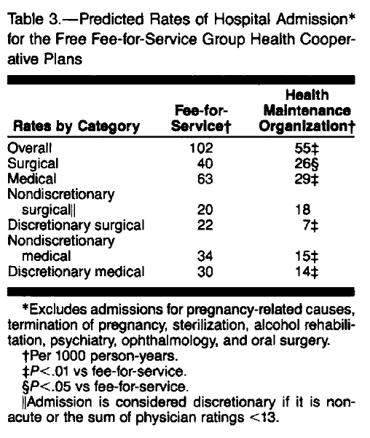

Slide 31
Lower “non-discretionary” medical admissions with no impact on health?
  Maybe …
Few in sample affected by reduced non-discretionary admissions. Adverse effect swamped in whole sample?
Iatrogenic disease risk balances service benefits?
HMOs substituted home or outpatient services for in-patient services.
Prevention not the reason – preventive services similar between HMO and FFS

Slide 32
Later HMO/FFS outcome differences
Ware, J.E., Bayliss, M.S., Rogers, W.H., Kosinski, M., Tarlov, A.R., "Differences in 4-Year Health Outcomes for Elderly and Poor, Chronically Ill Patients treated in HMO and Fee-for-Service Systems," JAMA, October 2, 1996, 276(13), pp. 1037-1047.

Slide 33
Ware 1996
4-year observational study of 2235 patients (18 to 97 years of age) with
  hypertension,
  non-insulin-dependent diabetes mellitus (NIDDM),
  recent acute myocardial infarction,
  congestive heart failure,
  depressive disorder
sampled from HMO and FFS systems in 1986 and followed up through 1990.

Slide 34
Average physical health declined and mental health remained stable during the 4-year follow-up period
Physical declines were larger for the elderly than for the nonelderly (P<.001).
For elderly patients, aged 65+ and on Medicare,
  Declines in physical health were more common in HMOs than in FFS plans (54% vs 28%; P<.001).
  Mixed results for mental health outcomes
Outcomes favored FFS over HMOs for the poor
Outcomes favored HMOs over FFS for the non-poor.

Slide 35
Forms of HMO
“Health Maintenance Organization”
Legal relationship between HMO and docs may be:
Docs own the HMO as, e.g., stockholders or partners.
  Prepaid group practice, also called "staff model."
  Docs can be salaried and also be partners.
    The Permanente medical group (the doctor half of Kaiser Plan) does this
or
HMO contracts with docs, who maintain private practices
  Independent Practice Association (IPA)

Slide 36
Forms of HMO
“Health Maintenance Organization”
Will HMO pay for visits to docs not in plan? (Doctors who are in the HMO constitute the "panel.")
No -- "closed panel." Closed panel HMOs do pay for services of outside doctors for patients who have exotic conditions that the HMO panel cannot handle, if specifically authorized by the HMO.
Yes -- "open panel." A fully open panel HMO would be a contradiction in terms. Compare PPOs.
"Gatekeeper" method: each subscriber gets a primary care doc who must approve in advance any visits to specialists. The HMO will pay for any service that the "Gatekeeper" approves, even if provided by a physician who is not a member of the panel. This intermediate form is common, used locally by Companion Care of S.C.

Slide 37
Other forms of managed care
PPO -- Preferred Provider Organization
  Has a panel, but the PPO pays a share of costs for services rendered by providers not on the panel.
  Providers in the panel are "preferred" by the PPO; it pays a higher percentage of the cost for their services.
POS -- Point of Service -- plans seem the same as PPOs to me.

Slide 38
How money flows in an IPA HMO
Bodenheimer and Grumbach, Capitation or Decapitation

Slide 39
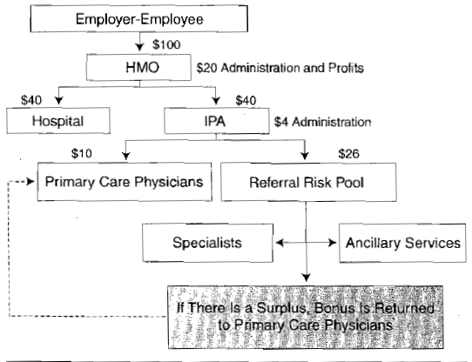

Slide 40
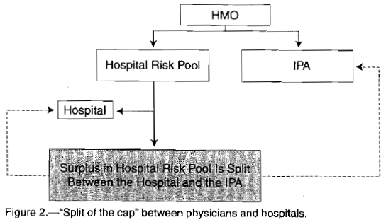

Slide 41
Incentive
HMO
Fee-for-service
Doctors have incentive to give less care.
Is prevention encouraged?
Doctors have incentive to give more care.
Is prevention encouraged?
Which is worse for patient trust in the doctor?

Slide 42
A problem with “choice”
THE MEDICARE-HMO REVOLVING DOOR — THE HEALTHY GO IN AND THE SICK GO OUT
Robert O. Morgan, Beth A. Viring, Carolee A. DeVito, and Nancy A. Persily, NEJM 1997

Slide 43
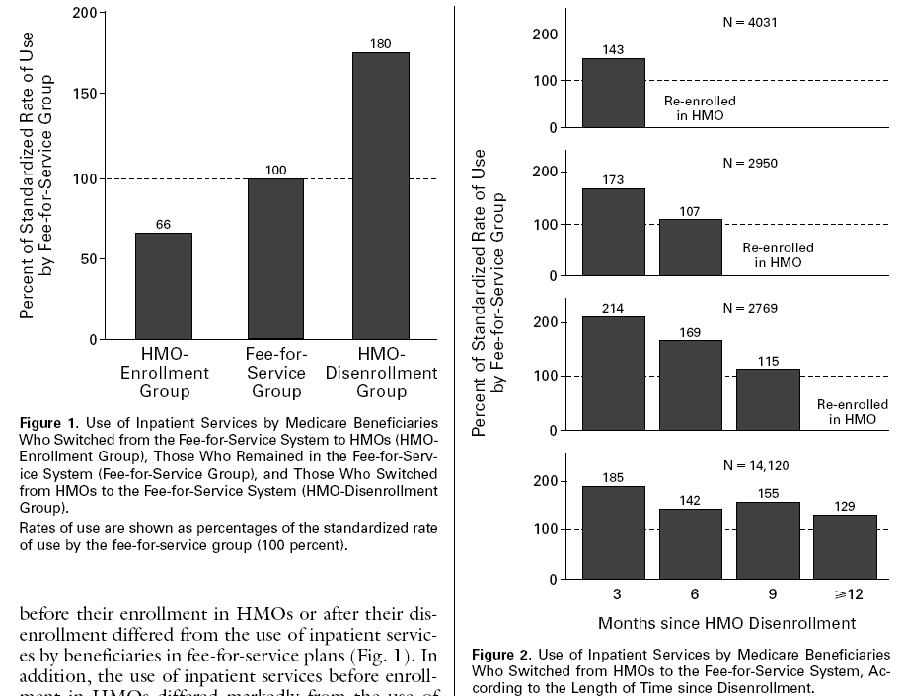

Slide 44
How health insurance competition is working
http://articles.latimes.com/2006/sep/17/business/fi-revoke17
http://www.calnurses.org/media-center/press-releases/2009/september/california-s-real-death-panels-insurers-deny-21-of-claims.html
http://www.consumerreports.org/health/insurance/health-insurance/overview/health-insurance-ov.htm

